Slide 1
The LARC Quality Improvement Collaborative: LEARNING SESSION III
CONTROL
LARC

Slide 2
Quality Improvement Collaborative Overview: Program Delivery
Introduction Webinar
Launch
Session I
Session II
Session III
Final Report
Smart Start
(on site)
Total Implementation Period = 6 Months
2 Months
2 months
2 months
1 Month
Project Outline
Action Period
Action Period
Action Period
Report
Completion
Preparation
Notes:
Still the collaborative model – learning sessions and action periods, but Shortened

Slide 3
CONTROL
Workbook, p. 77-84

Slide 5
SESSION | Introductory Webinar | Smart Start: 2-Day On-Site | Learning Session #1 | Learning Session #2 | Learning Session #3
CONTENT | Quality Improvement Primer - Guiding Principles DMAIC Model for Improvement Data/ Measurement Overview Stakeholder Analysis Team Formation Planning for Smart Start / Process Mapping | DEFINE / MEASURE Process Mapping Brainstorming / Affinity Diagram Prioritize Opportunities for Improvement (OFIs) Impact/Effort Grid Project Outline Problem Statement Scope Aim Statement / Metric Elevator Speech Action Plan Communication Plan | Quality Improvement Review Smart Start Outputs PDCA Overview Project Mgmt. Change Mgmt. Voice of Customer Critical to Quality Data/Measurement ANALYZE 5 Whys, Cause & Effect Diagram, Pareto Diagram, Spaghetti Diagram, Run Charts/Control Charts | IMPROVE Simulation Before/After PDCA / Small Test of Change Lean 5S Visual Management Physical Layout Standardized Work Future State Process Map Data Display | CONTROL Process Owner Transfer Control Plan Result Communication Final Report Storyboard Presentation Spread Best Practices Celebrate Success Additional Tools Chart Review Avoiding Pitfalls

Slide 6
IHI Video: Control Phase

Slide 7
Control
Define
Measure
Analyze
Improve
Control
Objectives
Tools
Ensure sustainability
Hand over to process owner
Control Plan
Communicate
Document the project
Share results
Spread Improvement
Celebrate
Control Plan
Audit/Performance Dashboard
Project closure documentation

Slide 8
Project Deliverables
On-Site / Session 1
DEFINE / MEASURE
Session 2
ANALYZE / IMPROVE
Session 3
CONTROL
Identify Stakeholders
Map the Process (Current State)
Identify / Prioritize Opportunities
Action Plan
Project Outline
Baseline Metrics / Data Collection Plan
VOC Information
Elevator Speech
Communication Plan
1 Rapid/Small Test of Change (PDSA)
Presentation
Root Cause Analysis
Fishbone Diagram, 5 Whys, or Pareto Chart
Update Project Outline, if necessary
2 or > Rapid/Small Test of Change (PDSA)
1 5S Exercise
1 Visual Management Application
Data Display
Create Future State Map
Create Standard Work
Presentation
Update Project Outline, if necessary
Validate Solution(s) / Interventions
Modify Solution(s) where necessary by additional Test of Change (PDSA)
Create Control Plan
Transfer to Operational Owner
Share/Spread Intervention, if applicable
Final Presentation
Project Champion

Slide 9
Session 2 Deliverables
Analyze / Improve
Update Project Outline, if necessary
Validate Solution(s) / Interventions
Modify Solution(s) where necessary by additional Test of Change (PDSA)
Create Control Plan
Transfer to Operational Owner
Share/Spread Intervention, if applicable
Final Presentation

Slide 10
Control Plan
Workbook, p. 78-79

Slide 11
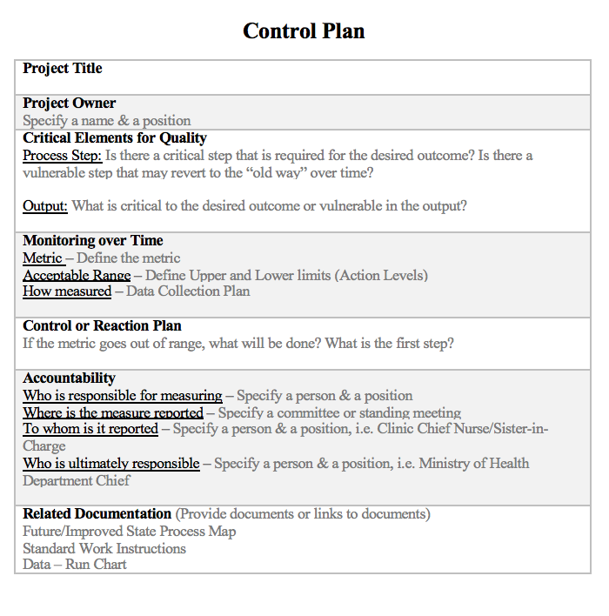
CONTROL PLAN
Continuous Touch Points
Workbook, p. 78-79
Notes:
Walk through the control plan form the Workbook, p. 79. explaining each section. During the faculty group work, assist each team to complete their control plan and add to the final report.

Slide 12
Sustain the Gains

Slide 13
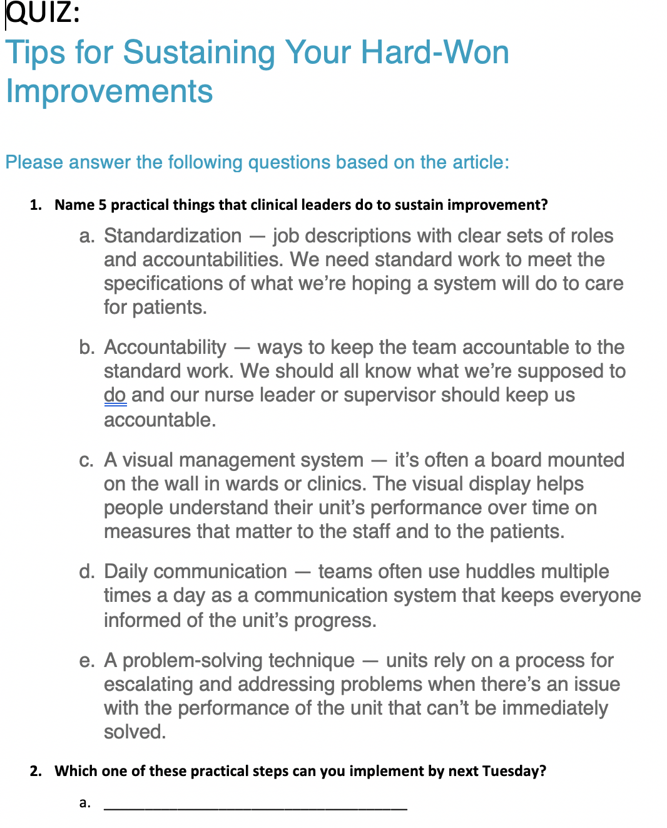
Notes:
Talk through each of the 5 practical things that clinical leaders can do to sustain improvement.

Slide 14
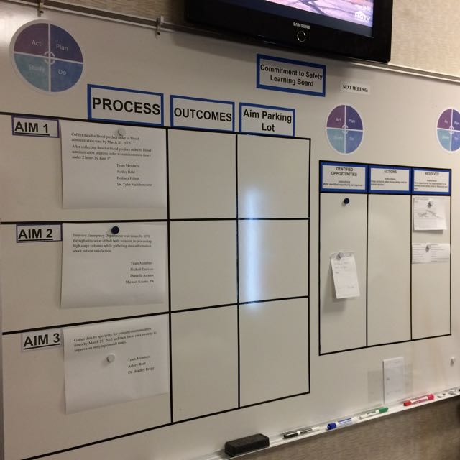
Two sides of the
Learning Board:
Project
Just Do It
Project
Just Do It

Slide 15
LEARNING BOARD
PROJECT |  |  | JUST DO IT
Aim / Metric | Changes |  | Identified Opportunities | Actions | Resolved

Slide 16
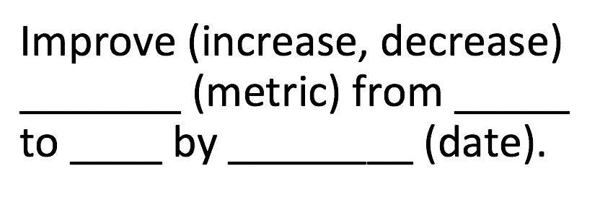
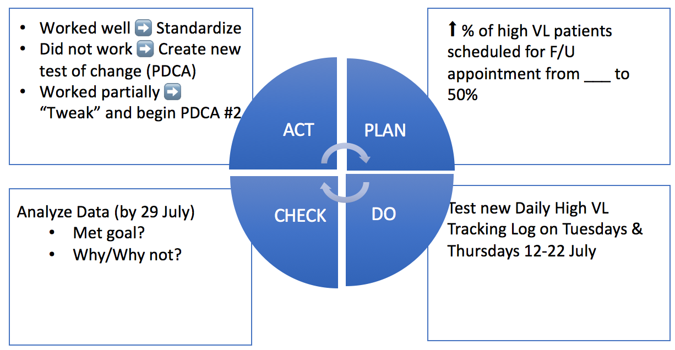
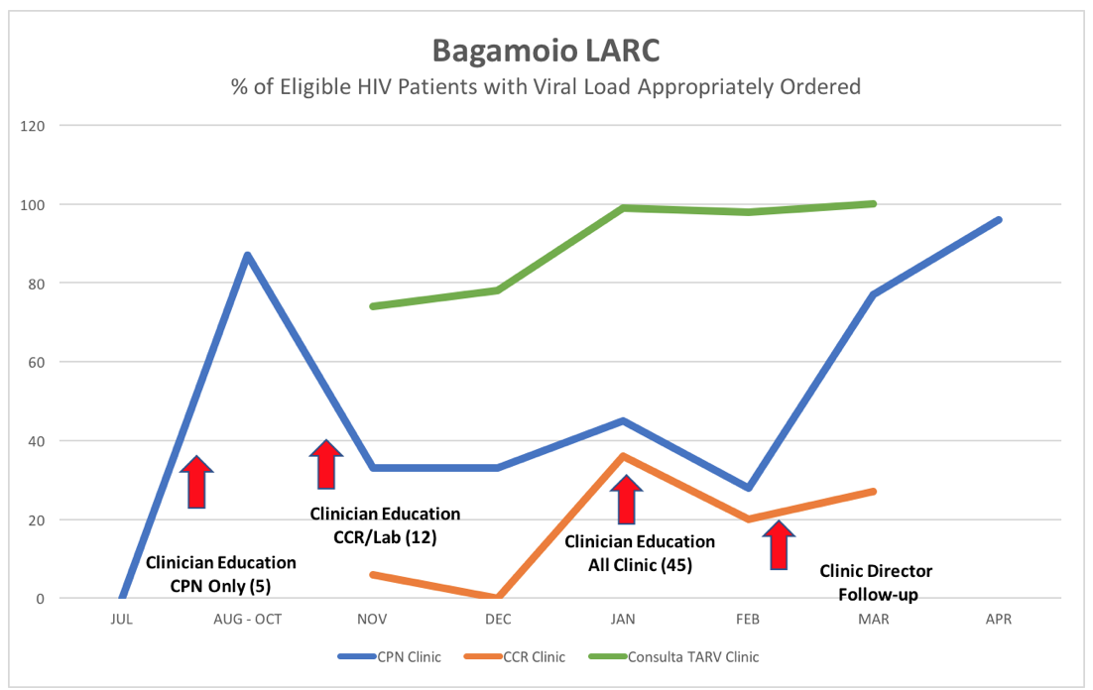
LEARNING BOARD
PROJECT |  |  | JUST DO IT
Aim / Metric | Changes |  | Identified Opportunities | Actions | Resolved

Slide 19
Notes:
Talk through each of the 5 practical things that clinical leaders can do to sustain improvement.

Slide 20
Control
Define
Measure
Analyze
Improve
Control
Objectives
Tools
Ensure sustainability
Hand over to process owner
Control Plan
Communicate
Document the project
Share results
Spread Improvement
Celebrate
Control Plan
Audit/Performance Dashboard
Project closure documentation

Slide 21
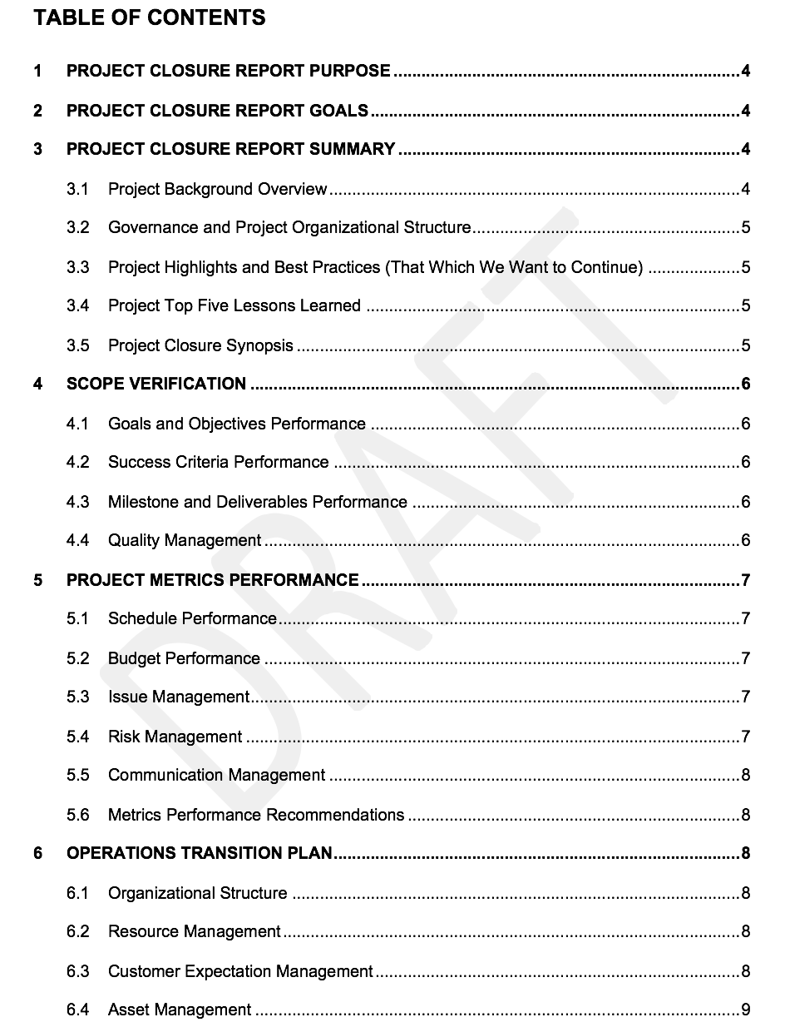
Project Closure Documents
Workbook, p. 80

Slide 22
FINAL REPORT PPT

Slide 23
Sharing Your Story
Convince the Stakeholders
Present Your Project
Publication
Notes:
If you happen to meet your key stakeholder/s and only have a quick 5 minutes, then you need to have your elevator speech honed and ready to “Convince the Stakeholders”.
If you are asked to provide a CPD or a 10 minute presentation to your facility or leadership – sharing what you have accomplished in your project – then you will need to “Present Your Project”.
For further communication, “Publication” may be necessary.
Choose from the above formats based on what you want to accomplish, your situation, and the time given.

Slide 24
Convince the Stakeholder
Making your story meaningful and impactful
Workbook, p. 83 & 84

Slide 25
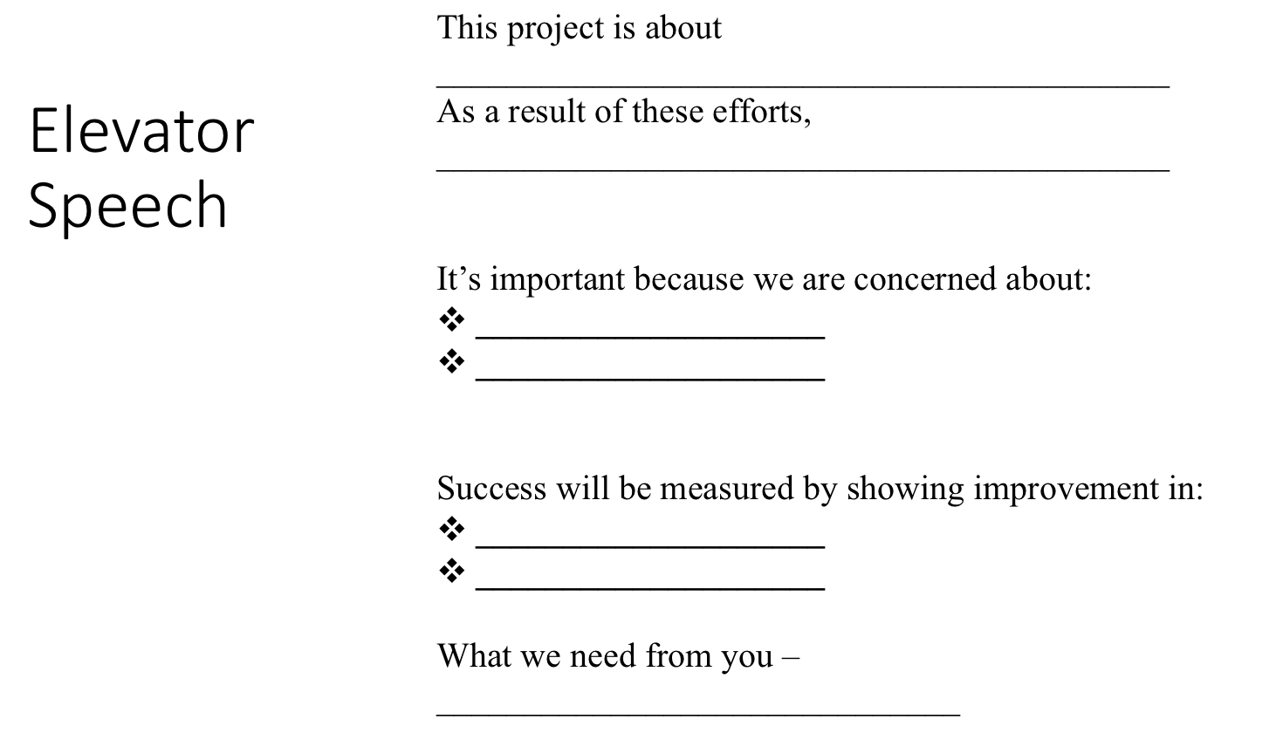
ACTIVITY
Convince the Stakeholder
30 min: Working as a team, revise & update your elevator speech, tailoring to address your assigned stakeholder.
Distracted Minister
Indifferent Governor
Busy Local Politician
Busy Hospital/Clinic Administrator
5 min: Role play with your assigned stakeholder
10 min: Debrief with the group
What you will need:
Workbook, p. 83 & 84
Notes:
Ground rules
Each team will be given 15 minutes to rewrite/refine and practice their elevator speech in order to convince a stakeholder.
The stakeholder and the conditions under which the participants will play out the role will be selected by the faculty.
Teams will choose their representative who will try and convince the stakeholder about their project.
Each team will be given five minutes (strictly enforced) to participate in this role play and fully convince the stakeholder.
Use official language understood by all.
The LARC faculty will be judges of the role plays.
All comments from plenary will be made after all the groups have presented to save on time (20 minutes at the end of the session).

Slide 26
No | Facility | Stakeholder | Time
1 |  | Disinterested Minister for Health that you met in an elevator | 5 Minutes
2 |  | Disinterested Minister for Health that you met in his/her office at 5 minutes to a lunch engagement with important developmental partners. | 5 Minutes
3 |  | Indifferent Governor – Met in between his/her meetings with the Director of Health | 5 Minutes
4 |  | Indifferent Governor – Met in the corridor near his/her office returning from a meeting | 5 Minutes
5 |  | Local Politician - During a break from the county assembly budget presentation day. | 5 minutes
6 |  | Local Politician - Met in the lobby of the County Assembly Chambers on his/her way to meet the Governor | 5 minutes
7 |  | Unconcerned Administrator - Met during his/her rounds at the Hospital | 5 minutes
8 |  | Unconcerned Administrator - Summoned the team to his office because funding cuts will affect the care. | 5 minutes
Notes:
Share with participants and stakeholders/actors prior to the activity.

Slide 27
Convince the Stakeholder Ground Rules
Stick to time allocated
Use official language understood by all
The LARC faculty will be judges of this role play
All comments from plenary will be made after all the groups have presented

Slide 28
Present Your Project

Slide 29
ACTIVITY
Preparing to Present Your Project
Working as a team, select the 9-12 Slides from your Final PPT Project Report that you would present to your stakeholder when you share your story.
Remember, this is an opportunity to tell the story of your work and its importance – not a technical presentation!
Present your slide selections to the group.
What you will need:
Your Final PPT Project Report
Note paper & pen
15 MIN
Notes:
Emphasize that the final PPT project report is a complete report of all that your team has done and as such includes all the technical tools used.
For a report to your stakeholders, i.e., your Quality improvement team, CME for your facility, a report to your administrator, etc. - you will want to tell a compelling story, so select your slides carefully.
15 minutes allotted for group work.

Slide 30
Slide Titles in the Final PPT Report
Title
Team
Facility Background
Stakeholder Analysis
The Story of Our Project
Project Summary
DEFINE - Elevator Speech
DEFINE - Process Mapping
DEFINE - Problem Statement
DEFINE - VOC
MEASURE - Metric Selection - Baseline Data
MEASURE - Data Collection Process
ANALYZE - Fishbone
IMPROVE - Impact Effort Grid
IMPROVE - Just Do Its
IMPROVE - 5S
IMPROVE - Visual Management
IMPROVE - PDSAs
IMPROVE - Intervention
IMPROVE - Before/After Process Map
IMPROVE - Run Chart
CONTROL – Control Plan
Challenges
Successes
Lessons Learned
Action Plan
Notes:
Refer to your actual PPT Final Report
Select from these Slide Titles

Slide 31
ACTIVITY
Preparing to Present Your Project
Working as a team, select the 9-12 Slides from your Final PPT Project Report that you would present to your stakeholder when you share your story.
Remember, this is an opportunity to tell the story of your work and its importance – not a technical presentation!
Present your slide selections to the group.
What you will need:
Your Final PPT Project Report
Note paper & pen
15 MIN
Notes:
Emphasize that the final PPT project report is a complete report of all that your team has done and as such includes all the technical tools used.
For a report to your stakeholders, i.e., your Quality improvement team, CME for your facility, a report to your administrator, etc. - you will want to tell a compelling story, so select your slides carefully.
15 minutes allotted for the debrief.
Ask each team what slides they selected. Write responses on Flip Chart at front of room.
Let other teams add any slide selections that they had that were different from the first team that shared their list.
Allow teams to discuss.
As a facilitator, give your input as to what you believe that the stakeholders would be most interested.

Slide 32
Publication
Storyboard / Poster
Paper
Notes:
While beyond the scope of this curriculum, the IHI modules do have many resources on publication.

Slide 33
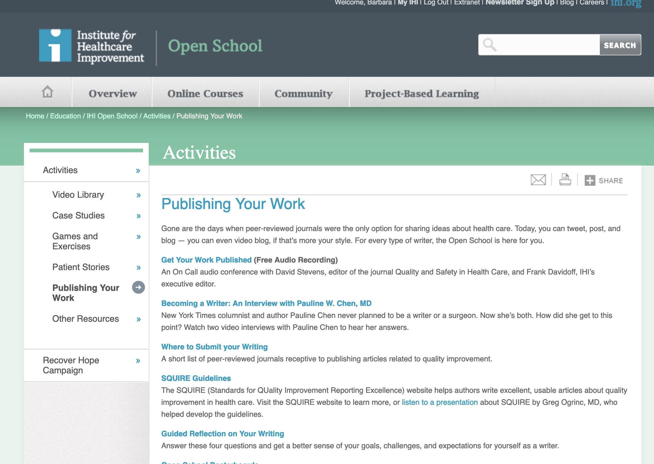
http://www.ihi.org/education/IHIOpenSchool/resources/Pages/Publications/default.aspx

Slide 34
Spread
Notes:
As part of your next steps, discuss the future of the interventions and how they might be spread.

Slide 35
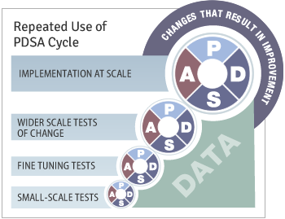
PDSA – Spread the Improvements

Slide 36
Celebrate

Slide 37
Celebrate
Congratulations!

Slide 38
Thank You
You are now Quality Ninjas!
Improvement is Continuous… What problem will you improve next?

